Slide 1
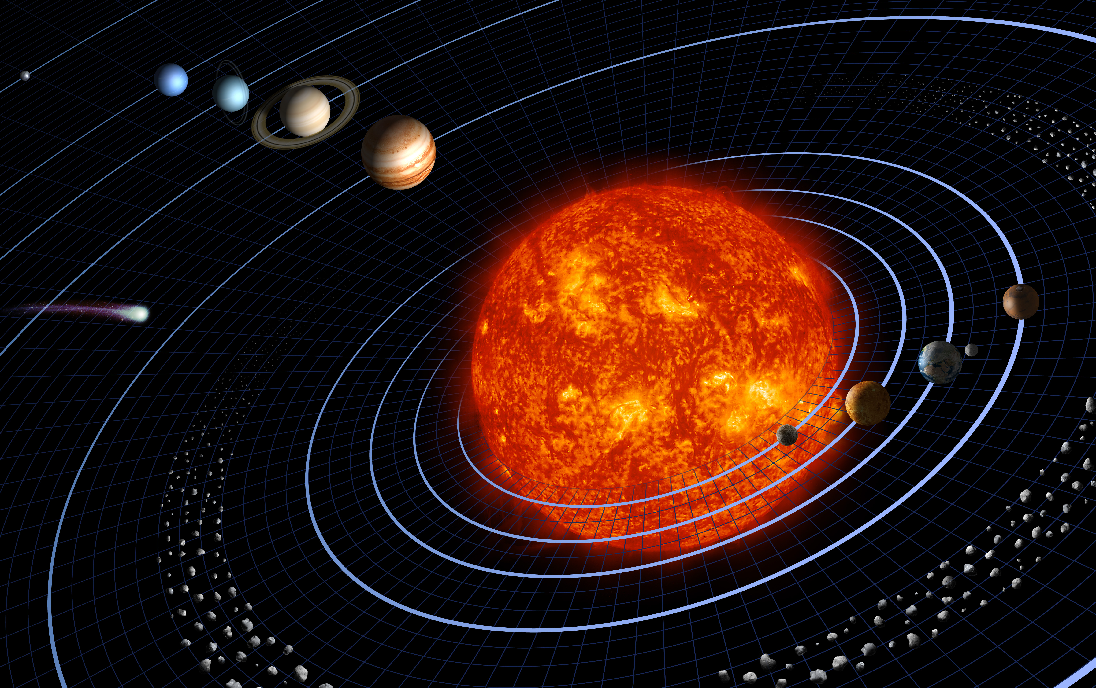
NUMERICAL MODEL OF THE SOLAR SYSTEM
Drew Chamberlain and Jake Seaton

Slide 2
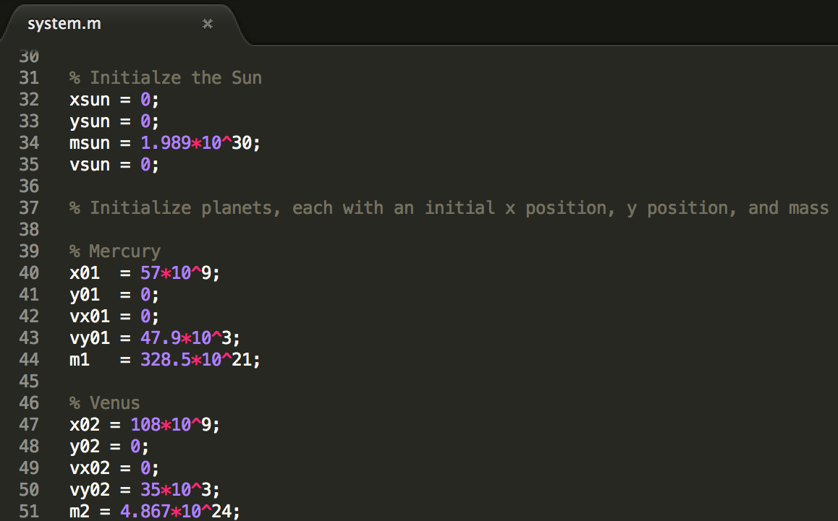
Creating a Planet

Slide 3
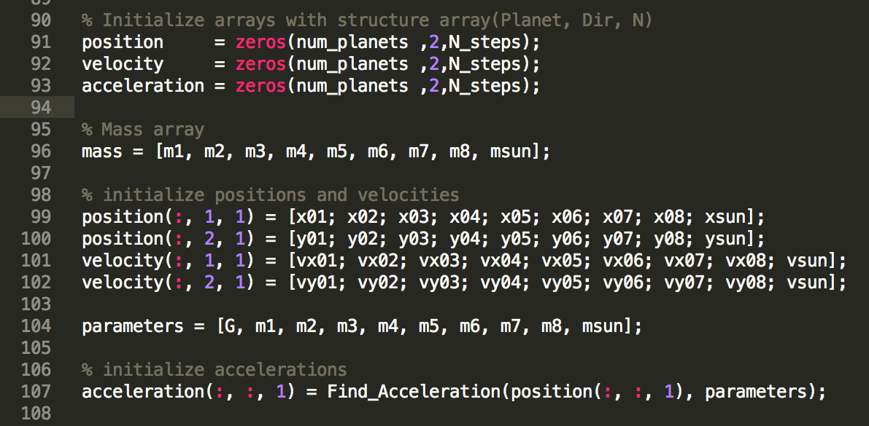
Tracking Motion

Slide 4
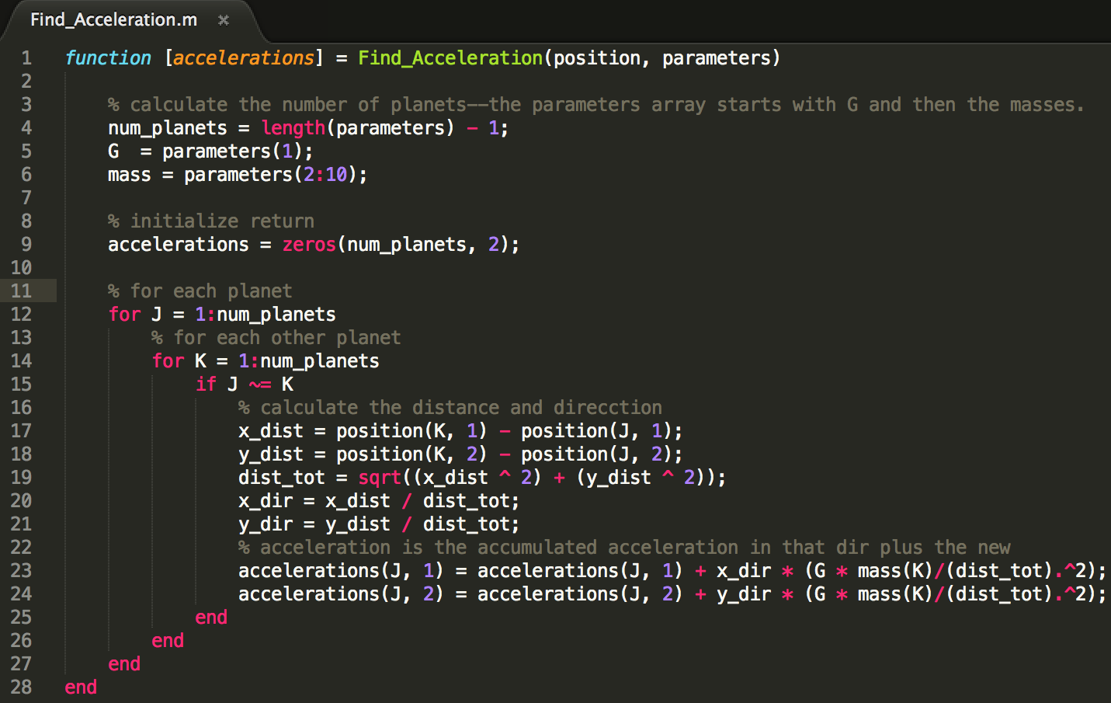
Calculating Acceleration

Slide 5
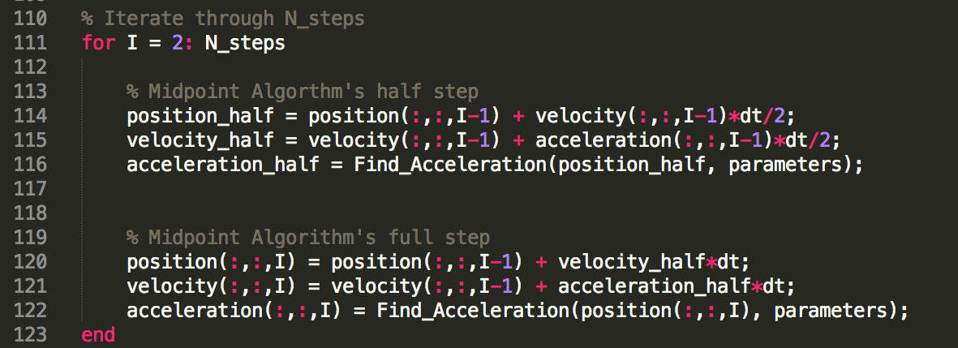
Midpoint Algorithm

Slide 6
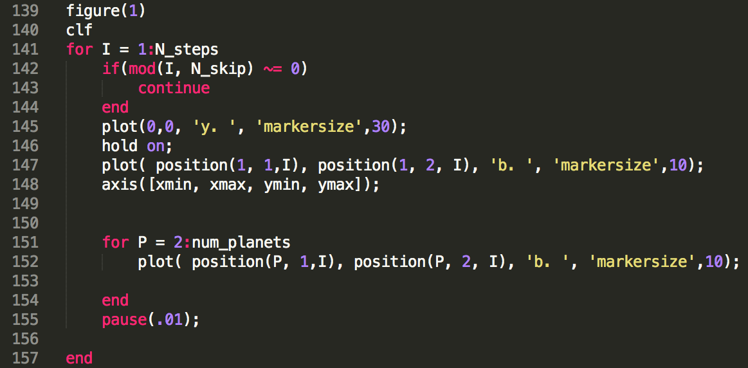
Visualization

Slide 7
Putting it all together

Slide 8
Things we learned
Abstraction is cool
If you compare our original script to the final one we individually computed the accelerations and it became a mess when we started adding planets. Then we used three dimensional arrays rather than single variables, and finally we created a function
Now to add a planet, just change the number of planets, initialize it, and add those initial variables to the initializer arrays.
To change the algorithm, just change the single for loop.
Do not mess with the matlab object layer.
Choose your algorithm wisely
Be careful putting a plot inside a for loop, and with the number of iterations you allow.

Slide 9
NEXT STEPS
Comets
Nonzero Y
Asteroids

